Slide 1

Data Analytics for Business
Indicator Variables and Interaction
Terms
Sridhar Narasimhan, Ph.D
Professor
Scheller College of Business
A Customer Analytics Dataset to Illustrate Indicator Variables

Slide 2



Lessons in this Module
A Customer Analytics Dataset to Illustrate Indicator Variables
Creating and Using Indicator (Dummy) Variables
Interpreting the Coefficients of Indicator Variables
Interaction Term and Interpreting its Coefficient
Another Example of Using Indicator Variables

Slide 3

Direct Marketing Dataset
A direct marketing firm has a data set containing information on past
customer behavior (actually the amount spent on buying products)
This is a simulated data which mimics data from a direct marketing company
We are interested in knowing which customer characteristics can predict AmountSpent (amount spent on buying products)
To answer questions like this we introduce indicator variable and
interaction terms and their interpretation

Slide 4
The Direct Marketing Dataset
Read the file “direct_marketing.csv” into a dataframe called dirmkt
dirmkt <- read_csv("direct_marketing.csv", col_types = list(
Age = col_factor(c("Old", "Middle", "Young")), # age group category Gender = col_factor(c("Female", "Male")), # Gender category OwnHome = col_factor(c("Own", "Rent")), # home owner or renter Married = col_factor(c("Single", "Married")), # single or married Location = col_factor(c("Far", "Close")), # near a store or far away Salary = col_double(), # annual salary
Children = col_integer(), # number of children
History = col_factor(c("High", "Low", "Medium","None")), # type of customer Catalogs = col_integer(), # number of catalogs sent to this customer AmountSpent = col_double())) # $ amount of purchases made by this customer

Slide 5
The Direct Marketing Dataset…
str(dirmkt) # what happened to the first row of the csv file? Classes ‘tbl_df’, ‘tbl’ and 'data.frame': 1000 obs. of 10 variables:
$ Age : Factor w/ 3 levels "Old","Middle",..: 1 2 3 2 2 3 2 2 2 1 ...
$ Gender
$ OwnHome
: Factor w/ 2 levels "Female","Male": 1 2 1 2 1 2 1 2 1 2 ...
: Factor w/ 2 levels "Own","Rent": 1 2 2 1 1 1 2 1 1 1 ...
$ Married : Factor w/ 2 levels "Single","Married": 1 1 1 2 1 2 1 1 2 2 ...
$ Location : Factor w/ 2 levels "Far","Close": 1 2 2 2 2 2 2 2 2 1 ...
$ Salary
$ Children
$ History
: num 47500 63600 13500 85600 68400 30400 48100 68400 51900 80700 ...
: int 0 0 0 1 0 0 0 0 3 0 ...
: Factor w/ 4 levels "High","Low","Medium",..: 1 1 2 1 1 2 3 1 2 4 ...
$ Catalogs : int 6 6 18 18 12 6 12 18 6 18 ...
$ AmountSpent: num 75.5 131.8 29.6 243.6 130.4 ...

Slide 6
First 10 Rows of the dirmkt Dataframe
Age | Gender | OwnHome | Married | Location | Salary | Children | History | Catalogs | AmountSpent
Old | Female | Own | Single | Far | 47500 | 0 | High | 6 | 75.5
Middle | Male | Rent | Single | Close | 63600 | 0 | High | 6 | 131.8
Young | Female | Rent | Single | Close | 13500 | 0 | Low | 18 | 29.6
Middle | Male | Own | Married | Close | 85600 | 1 | High | 18 | 243.6
Middle | Female | Own | Single | Close | 68400 | 0 | High | 12 | 130.4
Young | Male | Own | Married | Close | 30400 | 0 | Low | 6 | 49.5
Middle | Female | Rent | Single | Close | 48100 | 0 | Medium | 12 | 78.2
Middle | Male | Own | Single | Close | 68400 | 0 | High | 18 | 115.5
Middle | Female | Own | Married | Close | 51900 | 3 | Low | 6 | 15.8
Old | Male | Own | Married | Far | 80700 | 0 | None | 18 | 303.4

Slide 7
Exploring the dirmkt Dataframe
We would like to understand better the reasons why some individuals spend more than others
In particular, we would like to investigate whether salary has an influence on AmountSpent
So, how do we get started?
To keep matters clear, we start with AmountSpent, Salary

Slide 8
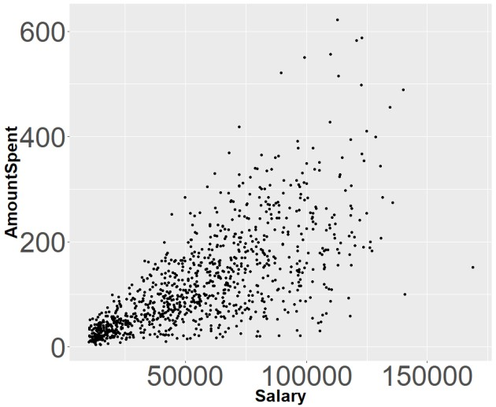
Scatterplot

Slide 9
RS: Simple Regression
 | Estimate | S.E. | t Value | Pr>|t|
Intercept | -1.531783 | 4.537416 | -0.338 | 0.736
Salary | 0.002196 | 0.000071 | 30.930 *** | <.001
R-squared | Adjusted R-squared
0.722 | 0.721
AmountSpent = b₀ + b₁*Salary

Slide 10
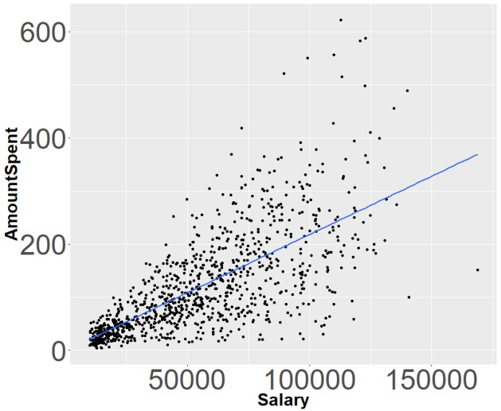
Scatterplot with Regression Line

Slide 11
Data Analytics for Business
Indicator Variables and Interaction
Terms
Sridhar Narasimhan, Ph.D
Professor
Scheller College of Business
Creating and Using Indicator (Dummy) Variables

Slide 12

What to do about the Categorical Variable
Age?
Age | Salary | AmountSpent
Old | 47500 | 75.5
Middle | 63600 | 131.8
Young | 13500 | 29.6
Middle | 85600 | 243.6
Middle | 68400 | 130.4
Young | 30400 | 49.5
Middle | 48100 | 78.2
Middle | 68400 | 115.5
Middle | 51900 | 15.8
Old | 80700 | 303.4
Is this categorical variable important?
Does being Middle-aged or Old potentially have an effect on AmountSpent compared to being Young?
How can we include the Age variable in a regression model that requires numeric values?

Slide 13
Doing Regression with Qualitative Predictor
Variable
Age
Old
Middle
Young
Middle
Middle
Young
Middle
Middle
Middle
Old
Consider the variable Age
We want to investigate the effect of Age on AmountSpent. Note that Age is a qualitative (or categorical) variable with three possible values: Young, Middle, or Old
We need to quantify this variable

Slide 14
Creating Indicator (Dummy) Variables
Since we have three possible values for Age, we need to create two indicator (or dummy) variables
The base (or reference) case, with both dummy variables set to 0, is
Age = Young. This is the reference group to compare for the other values of
the dummy variable. It is up to the modeler to determine which value of the categorical variable is used as the base case
The two dummy variables that we have created are:
𝑖𝑓 𝐴𝑔𝑒 = 𝑀𝑖𝑑𝑑𝑙𝑒
𝑜𝑡ℎ𝑒𝑟𝑤𝑖𝑠𝑒
AgeMid = ቊ^{1,}
0,
𝑖𝑓 𝐴𝑔𝑒 = 𝑂𝑙𝑑
0, 𝑜𝑡ℎ𝑒𝑟𝑤𝑖𝑠𝑒
AgeOld = ቊ^{1,}

Slide 15
Assigning Values (0 or 1) to the New Indicator (Dummy) Variables
Age | AgeMid | AgeOld
Old | 0 | 1
Middle | 1 | 0
Young | 0 | 0
Middle | 1 | 0
Middle | 1 | 0
Young | 0 | 0
Middle | 1 | 0
Middle | 1 | 0
Middle | 1 | 0
Old | 0 | 1
1, 𝑖𝑓 𝐴𝑔𝑒 = 𝑀𝑖𝑑𝑑𝑙𝑒
0, 𝑜𝑡ℎ𝑒𝑟𝑤𝑖𝑠𝑒
AgeMid = ቊ
𝑖𝑓 𝐴𝑔𝑒 = 𝑂𝑙𝑑
0, 𝑜𝑡ℎ𝑒𝑟𝑤𝑖𝑠𝑒
AgeOld = ቊ^{1,}
We then run the regression,
AmountSpent = b₀ + b₁*AgeMid + b₂*AgeOld

Slide 16
Quiz
With this Indicator variables coding scheme,
𝑖𝑓 𝐴𝑔𝑒 = 𝑀𝑖𝑑𝑑𝑙𝑒 _{AgeOld = ቊ}1,
𝑜𝑡ℎ𝑒𝑟𝑤𝑖𝑠𝑒 0,
𝑖𝑓 𝐴𝑔𝑒 = 𝑂𝑙𝑑
𝑜𝑡ℎ𝑒𝑟𝑤𝑖𝑠𝑒
AgeMid = ቊ^{1,}
0,
Can a record in the dirmkt dataframe have this value (AgeMid = 0, AgeOld = 0)? Answer: YES, because this record is for someone who is Young, i.e., the base case.
Can a record in the dirmkt dataframe have this value (AgeMid = 1, AgeOld = 1)? Answer: NO, every individual has to be in exactly one age category

Slide 17
Data Analytics for Business
Indicator Variables and Interaction
Terms
Sridhar Narasimhan, Ph.D
Professor
Scheller College of Business
Interpreting the Coefficients of Indicator Variables

Slide 18
A Linear Model With Indicator Variables
𝑖𝑓 𝐴𝑔𝑒 = 𝑀𝑖𝑑𝑑𝑙𝑒 _{AgeOld = ቊ}1,
𝑜𝑡ℎ𝑒𝑟𝑤𝑖𝑠𝑒 0,
𝑖𝑓 𝐴𝑔𝑒 = 𝑂𝑙𝑑
𝑜𝑡ℎ𝑒𝑟𝑤𝑖𝑠𝑒
AgeMid = ቊ^{1,}
0,
With this Indicator variables coding scheme, We then run the regression,
AmountSpent = b₀ + b₁*AgeMid + b₂*AgeOld
We then fit it using the data in dirmkt

Slide 19
DR1: 1st Regression with Dummy Variable
 | Estimate | S.E. | t Value | Pr>|t|
Intercept | 55.862 | 5.112 | 10.93*** | <.001
AgeMid | 94.307 | 6.395 | 14.75*** | <.001
AgeOld | 87.350 | 7.919 | 11.03*** | <.001
AmountSpent = b₀ + b₁*AgeMid + b₂*AgeOld
Which age group’s Average AmountSpent is $55.862? Young, Middle, or Old?
Correct Answer: With AgeMid = 0 and AgeOld = 0, b₀ captures the average AmountSpent of customers who are Young (base case)

Slide 20
AmountSpent = b0 + b1*AgeMid + b2*AgeOld
 | Estimate | S.E. | t Value | Pr>|t|
Intercept | 55.862 | 5.112 | 10.93*** | <.001
AgeMid | 94.307 | 6.395 | 14.75*** | <.001
AgeOld | 87.350 | 7.919 | 11.03*** | <.001
What is the Average AmountSpent for someone who is middle-aged?
This individual has AgeMid = 1 and AgeOld = 0, so b₀ + b₁ captures the
average AmountSpent for folks who are middle-aged
b₀ + b₁ = $55.862 + $94.307 = $150.169
So, $94.307 is the increase in AmountSpent (on average) for middle-aged customers compared to someone who is young

Slide 21
AmountSpent = b0 + b1*AgeMid + b2*AgeOld
 | Estimate | S.E. | t Value | Pr>|t|
Intercept | 55.862 | 5.112 | 10.93*** | <.001
AgeMid | 94.307 | 6.395 | 14.75*** | <.001
AgeOld | 87.350 | 7.919 | 11.03*** | <.001
What is the Average AmountSpent for someone who is old?
This individual has AgeMid = 0 and AgeOld = 1, so b₀ + b₂ captures the average AmountSpent for customers who are old
b₀ + b₂ = $55.862 + $87.350 = $143.212
So, $ 87.350 is the increase in AmountSpent (on average) for old customers compared to someone who is young

Slide 22
Graphically
Let’s take a look at this graphically…

Slide 23
Middle
b₀ + b₁ =
$55.862 + $94.307
b₀ + b₂ =
$55.862 + $87.350
AmountSpent in $
Old
b₁ = $94.307
b₂ = $87.350
Young
b₀ = $55.862
b₀ = $55.862
Young
Middle
Age
Old

Slide 24
Important Note
You can directly use a Factor Variable in regression in R instead of creating & using Dummy variables
lm(AmountSpent ~ Age, data=dirmkt)
 | Estimate | Std. Error | t value | Pr(>|t|)
(Intercept) | 143.213 | 6.048 | 23.678 | <2e-16 ***
AgeMiddle | 6.956 | 7.165 | 0.971 | 0.332
AgeYoung | -87.350 | 7.919 | -11.030 | <2e-16 ***
What is the base case? What is the average AmountSpent for the base case? The Base Case is Old with Average AmountSpent = $143.213
What is the Average AmountSpent of Young? $143.213 - $87.350 = $55.863
What is the Average AmountSpent of Middle? $143.213 + $6.956 = $150.169
All three groups have the same answers as our coding scheme where Young was the base case!!!

Slide 25
R’s Indicator variable coding
R’s indicator variable coding scheme can be found by using:
contrasts(dirmkt$Age)
Old | Middle 0 | Young 0 | (Old is the base case in this coding scheme)
Middle | 1 | 0
Young | 0 | 1
In this case R uses a different coding scheme for dummy variables
I find it more useful to use my own coding scheme!

Slide 26
DR2: 2nd Regression with Salary and
Dummy Variables
 | Estimate | S.E. | t Value | Pr>|t|
Intercept | -6.12 | 4.72 | -1.30 | 0.20
Salary | .002 | .00009 | 25 | <.001
AgeMid | -4.81 | 6.39 | -0.75 | 0.45
AgeOld | 23.28 | 6.72 | 3.46 | <.001
AmountSpent = b₀ + b₁*Salary + b₂*AgeMid + b₃*AgeOld
What is the (average) increase in AmountSpent for a one unit increase in Salary?
Answer: $.002

Slide 27
Graphically
Graphically, AmountSpent = b0 + b1*Salary + b2*AgeMid + b3*AgeOld
would look like this…

Slide 28
Slope of all 3 lines = b₁ = 0.002
Old
AmountSpent, in $
$23.28
Young
Middle
b₃= $23.28
-$4.81
b₀ = $-6.12
Salary
b₂= -$4.81

Slide 29
Quiz
 | Estimate | S.E. | t Value | Pr>|t|
Intercept | -6.12 | 4.72 | -1.30 | 0.20
Salary | .002 | .00009 | 25 | <.001
AgeMid | -4.81 | 6.39 | -0.75 | 0.45
AgeOld | 23.28 | 6.72 | 3.46 | <.001
AmountSpent = b0 + b1*Salary + b2*AgeMid + b3*AgeOld
What does this result mean?
Middle-aged customers spend the most
Old customers spend the least
Old customers spend more that young customers
At the same salary level, old customers spend more than young customers What is the current answer?
D. At the same salary level, old customers spend more than young customers

Slide 30

Data Analytics for Business
Indicator Variables and Interaction
Terms
Sridhar Narasimhan, Ph.D
Professor
Scheller College of Business
Interaction Term and Interpreting its Coefficient

Slide 31
Next Regression with Dummy Variables
In the same dataset, Location is a categorical variable with a
value equal to “Close” if the customer lives close to a store that sells similar merchandise, and has a value equal to “Far” otherwise
𝑖𝑓 𝐿𝑜𝑐𝑎𝑡𝑖𝑜𝑛 = 𝐹𝑎𝑟
𝑜𝑡ℎ𝑒𝑟𝑤𝑖𝑠𝑒
Far = ቊ^{1,}
0,
We want to study the impact of Location on AmountSpent
AmountSpent = b₀ + b₁Salary + b₂Far
 | Estimate | S.E. | t Value | Pr>|t|
Intercept | -20.480 | 4.413 | -4.64 | <.0001
Salary | 0.002 | 0.00007 | 34.05 | <.0001
Far | 59.060 | 4.414 | 13.38 | <.0001
Multiple R-Squared: 0.5672, Adjusted R-squared: 0.5663

Slide 32
Or Graphically…
AmountSpent
Far
Close
Salary

Slide 33
 | Estimate | S.E. | t Value | Pr>|t|
Intercept | -20.480 | 4.413 | -4.64 | <.0001
Salary | 0.002 | 0.00007 | 34.05 | <.0001
Far | 59.060 | 4.414 | 13.38 | <.0001
AmountSpent = b₀ + b₁Salary + b₂Far
What is the estimated AmountSpent for a customer who lives far? A. 59.06
B. -20.48
C. -20.48 + 0.002 * Salary
D. 38.58 + 0.002 * Salary
For this customer since Far =1, the correct answer is
D. because AmountSpent = -20.48 + .002* Salary +59.06 * 1
= 38.58 + .002*Salary

Slide 34
But…
AmountSpent = b₀ + b₁Salary + b₂Far
In the above model, we assume that customers who live far away
from a store that sells similar products will spend (at our direct market firm) at the same rate as customers who live close to a store
Is this assumption realistic?
So, can we investigate another scenario that the spending rate may
be different? So how should we change the model?

Slide 35
Interaction Term
Is spending rate higher for customers how live far away?
To answer this question we need to construct a new variable SalaryFar
SalaryFar = Salary * Far, is an Interaction Term
AmountSpent = b₀ + b₁Salary + b₂Far + b₃SalaryFar

Slide 36
Regression with Dummy Variable and Interaction Term
AmountSpent = b₀ + b₁Salary + b₂Far + b₃SalaryFar
 | Estimate | S.E. | t Value | Pr>|t|
Intercept | 1.448 | 4.808 | 0.30 | 0.76
Salary | 0.002 | 0.000 | 24.72 | <.0001
Far | -13.460 | 8.680 | -1.55 | 0.12
SalaryFar | 0.001 | 0.000 | 9.57 | <.0001
Multiple R-Squared: 0.6036,
Adjusted R-squared: 0.6024
What does this result mean?

Slide 37
Regression with Experience, Dummy Variables,
and Interaction Term
 | Estimate | S.E. | t Value | Pr>|t|
Intercept | 1.448 | 4.808 | 0.30 | 0.76
Salary | 0.002 | 0.000 | 24.72 | <.0001
Far | -13.460 | 8.680 | -1.55 | 0.12
SalaryFar | 0.001 | 0.000 | 9.57 | <.0001
AmountSpent = b₀ + b₁Salary + b₂Far + b₃SalaryFar
How would you interpret b₃ the coefficient of SalaryFar?
b₃ is the amount to add to b₁ to get the slope for individuals who live far away

Slide 38
Graphically
AmountSpent = b₀ + b₁Salary + b₂Far + b₃SalaryFar
Far
Slope= b₁ + b₃
Close
Slope= b₁
AmountSpent
b₀
b₀ + b₂
Salary

Slide 39
Test Your Understanding
AmountSpent = b₀ + b₁Salary + b₂Far + b₃SalaryFar
If the salary of a customer who lives close increases by $10,000, what is the
predicted increase in AmountSpent for that customer?
For this customer (i.e., the baseline case), Far = 0, thus the relevant slope is b₁ = 0.002
Hence, the increase in AmountSpent (on average) for this individual = $.002*10000 =
$20
If the salary of a customer who lives far away increases by $10,000, what is the predicted increase in AmountSpent for that customer?
For this customer, Far = 1, hence the relevant slope is b₁ + b₃ = 0.002 + 0.001 = 0.003
Hence, the increase in AmountSpent (on average) for this individual = $.003*10000 =
$30

Slide 40
Categorical Variable with M Values
If a categorical (factor) variable has M possible values, then you will need to construct and use M-1 indicator (dummy) variables
Be careful when using and interpreting the value of the coefficients of the dummy variable and the value of the coefficients for any interaction terms
Remember the base case applies to the group where all indicator variables
are set to 0
All other cases have to be interpreted with reference to the base case

Slide 41
Data Analytics for Business
Indicator Variables and Interaction
Terms
Sridhar Narasimhan, Ph.D
Professor
Scheller College of Business
Another Example of Using Indicator Variables

Slide 42
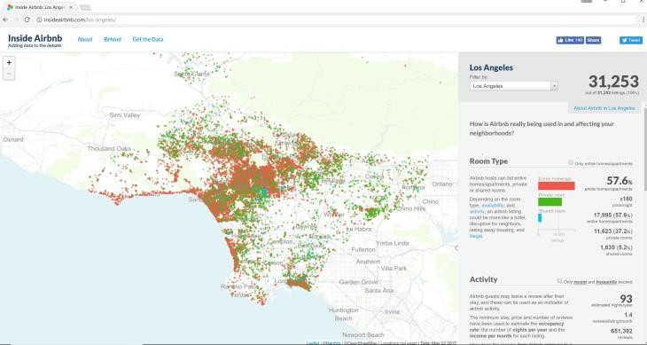
AirBnB – Los Angeles Rental Market
Listing data on AirBnB is publicly available at http://insideairbnb.com/los-
angeles/ and http://insideairbnb.com/get-the-data.html .

Slide 43
About the Data
Listing data collected on May 2, 2017
We discarded listings with price greater than $1000 and missing values for beds, baths, and rating
$ Price
$ Reviews
$ Beds
$ Baths
$ Capacity
: num 50 55 150 30 45 80 120 55 50 50 ...
: int 33 14 22 3 38 42 15 58 19 1 ...
: int 1 1 3 1 1 2 1 2 1 1 ...
: num 1 1 1 1 1 1.5 1 2 0 2 ...
: int 2 2 6 1 2 2 2 3 1 2 ...
$ Monthly_Reviews : num 1.91 1.72 2.12 0.18 7.92 1.89 1.96 2.98 0.53 0.04 ...
$ Room_Type
$ Rating
: Factor w/ 3 levels "Shared room",..: 2 2 3 2 2 2 3 2 2 2 ...
: int 93 100 100 93 98 99 99 92 89 NA ...

Slide 44
Research Questions
If a property owner aims to get a higher price for his or her property, then it is essential to understand the key factors that influence price
What variables influence listing price?
Is there a relationship between capacity and price?
Does the type of rental (shared, private or full house) change this relationship?

Slide 45
Data Wrangling
la_listing <- la_listing %>%
mutate(Price = str_replace(Price, "[$]", "")) %>% mutate(Price = str_replace(Price, "[,]", "")) %>% mutate(Price = as.numeric(Price)) %>%
Convert price to numeric and room_type to factor
mutate(Room_Type = factor(Room_Type, levels = c("Shared room", "Private room", "Entire home/apt"))) %>% mutate(Capacity_Sqr = Capacity * Capacity) %>%
mutate(Beds_Sqr = Beds * Beds) %>% mutate(Baths_Sqr = Baths * Baths) %>% mutate(ln_Reviews = log(1+Reviews)) %>% mutate(ln_Monthly_Reviews = log(1+Monthly_Reviews)) mutate(ln_Price = log(1+Price)) %>%
mutate(ln_Beds = log(1+Beds)) %>% mutate(ln_Baths = log(1+Baths)) %>%
mutate(ln_Capacity = log(1+Capacity)) %>%
mutate(ln_Rating = log(1+Rating)) %>%
Create squared terms for testing non-linear relations
Create log terms for testing non-linear relations
mutate(Shared_ind = ifelse(Room_Type == "Shared room",1,0)) %>% mutate(House_ind = ifelse(Room_Type == "Entire home/apt",1,0)) %>% mutate(Private_ind = ifelse(Room_Type == "Private room",1,0)) %>% mutate(Capacity_x_Shared_ind = Shared_ind * Capacity) %>% mutate(Capacity_x_House_ind = House_ind * Capacity) %>% mutate(Capacity_x_Private_ind = Private_ind * Capacity) %>% mutate(ln_Capacity_x_Shared_ind = Shared_ind * ln_Capacity) %>% mutate(ln_Capacity_x_House_ind = House_ind * ln_Capacity) %>% mutate(ln_Capacity_x_Private_ind = Private_ind * ln_Capacity)
Create dummy variables for room_type
Create interaction terms
filter(Price < 1000 , !is.na(Beds), !is.na(Baths), !is.na(Price), !is.na(Rating))
Filter unwanted data

Slide 46
2RS: Simple Regression – How Does Price
Vary by Room Capacity?
Price = b₀ + b₁*Capacity
 | Estimate | S.E. | t Value | Pr>|t|
Intercept | 15.039 | 1.141 | 13.19*** | <.001
Capacity | 38.272 | 0.316 | 114.72*** | <.001
R-squared | Adjusted R-squared
0.367 | 0.367

Slide 47
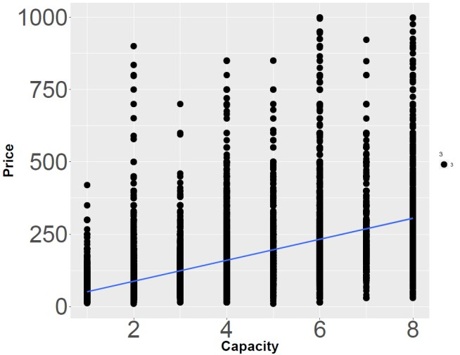
Scatterplot with Regression Line

Slide 48
Creating Indicator (Dummy) variables
We define two dummy variables:
𝑖𝑓 𝑅𝑜𝑜𝑚 𝑡𝑦𝑝𝑒 = "𝑃𝑟𝑖𝑣𝑎𝑡𝑒 𝑟𝑜𝑜𝑚"
𝑜𝑡ℎ𝑒𝑟𝑤𝑖𝑠𝑒
Private_ind = ቊ^{1,}
0,
𝑖𝑓 𝑅𝑜𝑜𝑚 𝑡𝑦𝑝𝑒 = "𝐸𝑛𝑡𝑖𝑟𝑒 ℎ𝑜𝑚𝑒/𝑎𝑝𝑡"
𝑜𝑡ℎ𝑒𝑟𝑤𝑖𝑠𝑒
House_ind = ቊ^{1,}
0,
The base (or reference) case, with both dummy variables set to 0, is Room type = “Shared.” This is the reference group to compare for the other values of the dummy variable

Slide 49
2DR1: How Does Price Vary by Room Type?
Price = b₀ + b₁*Private_ind + b₂*House_ind (only dummies)
 | Estimate | S.E. | t Value | Pr>|t|
Intercept | 37.149 | 2.954 | 12.58*** | <.001
Private_ind | 35.666 | 3.123 | 11.42*** | <.001
House-ind | 133.442 | 3.058 | 43.64*** | <.001
Which room type’s Average Price is $37.149? Shared room
What is the Average Price of a Private Room? $37.149 + $35.666
What is the Average Price of an Entire House? $37.149 + $133.442

Slide 50
Graphically
Let’s take a look at this graphically…

Slide 51
House
$37.149 + $133.442
$133.442
Private Room
$37.149 + $35.666
Price
$35.666
Shared room
$37.149
$37.149
Shared Room
Private Room
House
Type of Room Rental

Slide 52
2DR2: 2nd Regression with Capacity and
Dummy Variables
 | Estimate | S.E. | t Value | Pr>|t|
Intercept | -19.017 | 2.678 | -7.101 | <.001
Capacity | 29.292 | 0.355 | 82.605 | <.001
Private_ind | 30.339 | 2.739 | 11.076 | <.001
House-ind | 75.776 | 2.771 | 27.346 | <.001
Price = b₀ + b₁*Capacity + b₂*Private_ind + b₃*House_ind
What is the (average) increase in Price for each additional individual?
Answer: $29.292

Slide 53
Graphically
Let’s take a look at Price = b₀ + b₁*Capacity + b₂*Private_ind + b₃*House_ind
graphically…

Slide 54
House
$75.776
Private Room
Price
b₃= $75.776
$30.339
Shared Room
b₂= $30.339
Slope of all 3 lines = b₁ = 29.292
b₀ = -$19.017
Capacity
Price = b₀ + b₁*Capacity + b₂*Private_ind + b₃*House_ind

Slide 55
Interaction Terms
Construct two new variables:
P_Cap = Private-ind*Capacity
H_Cap = House_ind*Capacity
P_Cap and H_Cap are the Interaction terms.
The new regression is:
Price = b₀ + b₁*Capacity + b₂*Private_ind + b₃*House_ind + b₄*P_Cap + b₅*H_Cap

Slide 56
DR3: 3rd Regression with Capacity, Dummy
Variables, and Interaction Terms
 | Estimate | S.E. | t Value | Pr>|t|
Intercept | 35.885 | 4.111 | 8.728*** | <.001
Capacity | 0.659 | 1.687 | 0.391 | 0.695980
Private_ind | 20.684 | 4.672 | 4.427*** | <.001
House_ind | 2.293 | 4.423 | 0.518 | 0.604147
P_Cap | 7.080 | 1.947 | 3.636*** | <.001
H_Cap | 33.414 | 1.729 | 19.323*** | <.001
Price = b₀ + b₁*Capacity + b₂*Private_ind + b₃*House_ind + b₄*P_Cap + b₅*H_Cap
How would you interpret b₄ and b₅ the coefficients of P_Cap and H_Cap?
b₄ is the amount to add to b₁ to get the slope for a Private room
b₅ is the amount to add to b₁ to get the slope for a House
Statistically, Capacity (slope) and House_ind (bump in intercept) are not very different from 0

Slide 57
Graphically
Let’s take a look at
Price = b₀ + b₁*Capacity + b₂*Private_ind + b₃*House_ind + b₄*P_Cap + b₅*H_Cap
graphically…

Slide 58
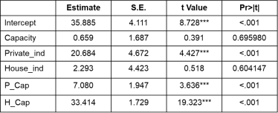
House
Slope = b₁ + b₅
= 0.659 + 33.414
Private Room
Slope = b₁ + b₄ = 0.659 + 7.080
Price
b₀ + b₂ = 35.89 + 20.68
Shared Room
b₀ + b₃ = 35.589 + 2.29
b₀ = 35.89
Slope = b = 0.659
1
Capacity
Price = b₀ + b₁*Capacity + b₂*Private_ind + b₃*House_ind + b₄*P_Cap + b₅*H_Cap

Slide 59
Recap of this Module
A Customer Analytics Dataset to Illustrate Indicator Variables
Creating and Using Indicator (Dummy) Variables
Interpreting the Coefficients of Indicator Variables
Interaction Term and Interpreting its Coefficient
Another Example of Using Indicator Variables

